Slide 1

MEMBER NAME (RRN)
Shabana M. (180071601035)
Taslima parveen S.Z. (180071601047)
BUILD A REAL-TIME TRANSLATION APP THAT CAN LISTEN AND SPEAK
O^{th} Review 27.12.21

Slide 2
SUPERVISOR : Dr. SHARMILA SANKAR
DESIGNATION: Professor
BUILD A REAL-TIME TRANSLATION APP THAT CAN LISTEN AND SPEAK
O^{th} Review 27.12.21

Slide 3
DOMAIN
Natural Language Processing(NLP)
BUILD A REAL-TIME TRANSLATION APP THAT CAN LISTEN AND SPEAK
O^{th} Review 27.12.21

Slide 4
TITLE OF THE PROJECT
Build a real-time translation app that can listen and speak.
BUILD A REAL-TIME TRANSLATION APP THAT CAN LISTEN AND SPEAK
O^{th} Review 27.12.21

Slide 5
ABSTRACT
The aim is to automate the application to overcome language barrier.
The application recognizes speech in one language to another user defined language.
Includes speech recognition, language translation and speech synthesis.
The application accepts text written and converts it into the language needed by recognizing the text present in the image or captured using camera.
BUILD A REAL-TIME TRANSLATION APP THAT CAN LISTEN AND SPEAK
O^{th} Review 27.12.21

Slide 6
A language will be chosen from a list of options in which the text is to be entered.
Also the language in which the text is to be translated is also selected from the list of options.
After selecting the languages, the translate button will be clicked to translate.
BUILD A REAL-TIME TRANSLATION APP THAT CAN LISTEN AND SPEAK
O^{th} Review 27.12.21

Slide 7
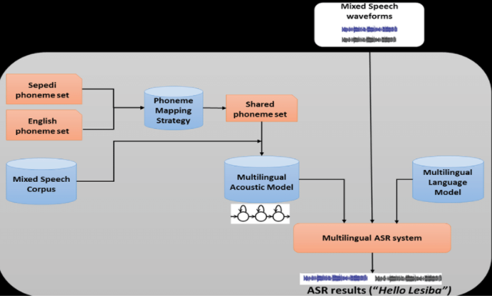
ARCHITECTURE DIAGRAM
BUILD A REAL-TIME TRANSLATION APP THAT CAN LISTEN AND SPEAK
O^{th} Review 27.12.21

